Slide 1
Where is the relief? The disconnect between US foreign aid and Syrian refugee populations
Marissa Marinello
Spring 2019

Slide 2
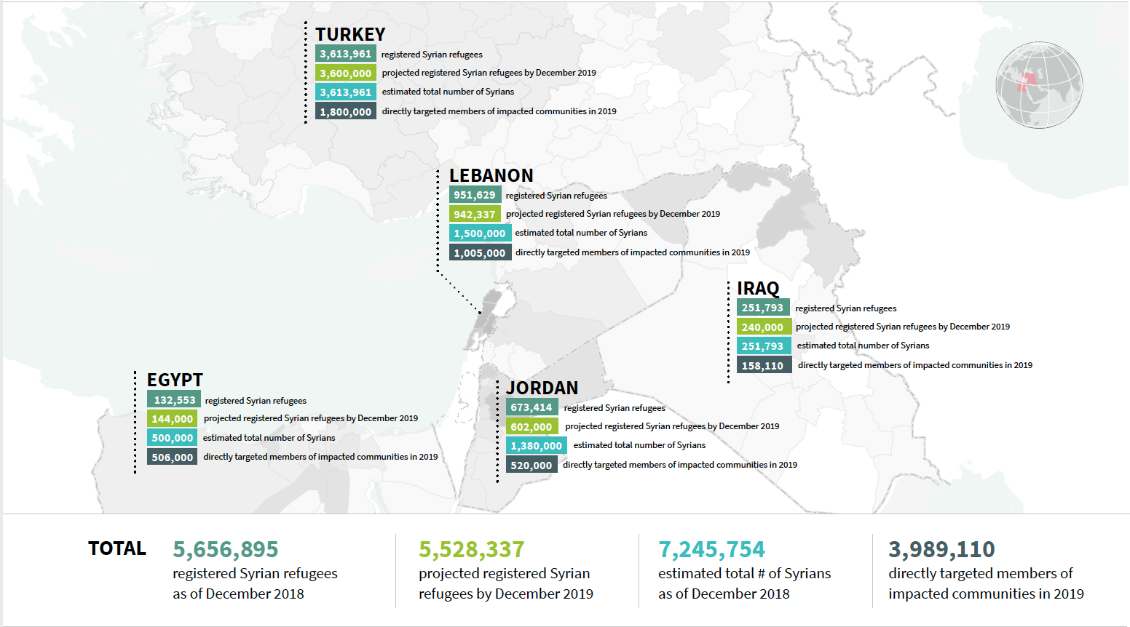
Syrian Refugee Crisis – Regional Impacts
Source: United Nations High Commissioner for Refugees
Notes:
Put the focus of the slide as the title and actually say what the issue is and what the slide is about (1 sentence)
Rather than saying “the issue” say something like “underfunding of UNHCR programs to support Syrians”

Slide 3
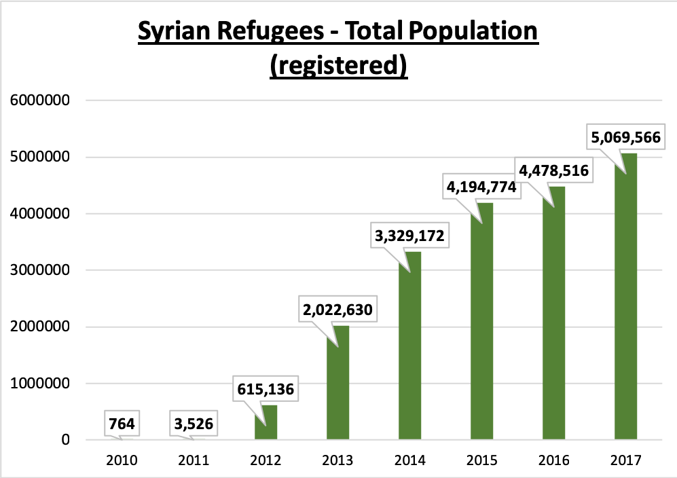
Total Population – Time Series

Slide 4
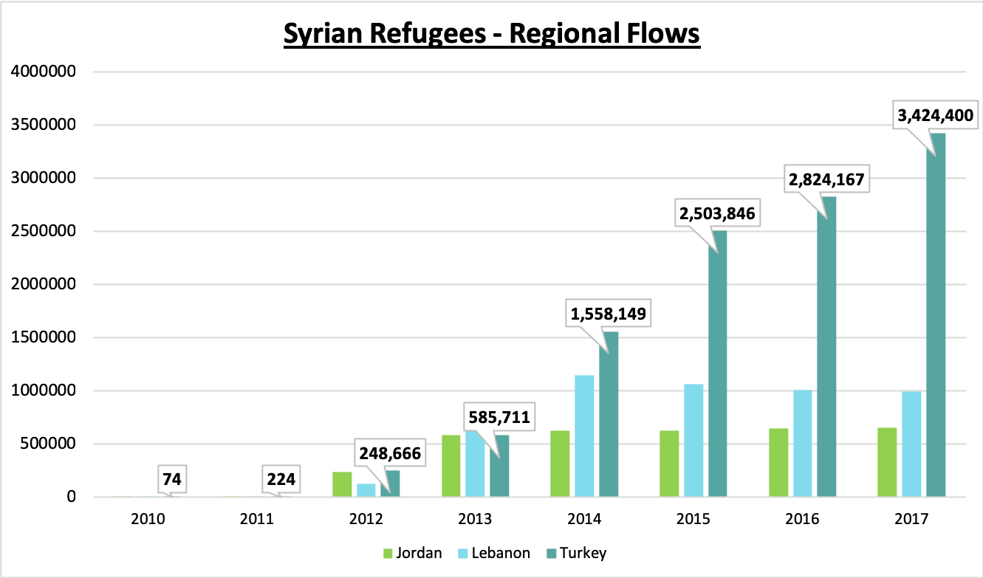
Reginal Flows – Time Series

Slide 5
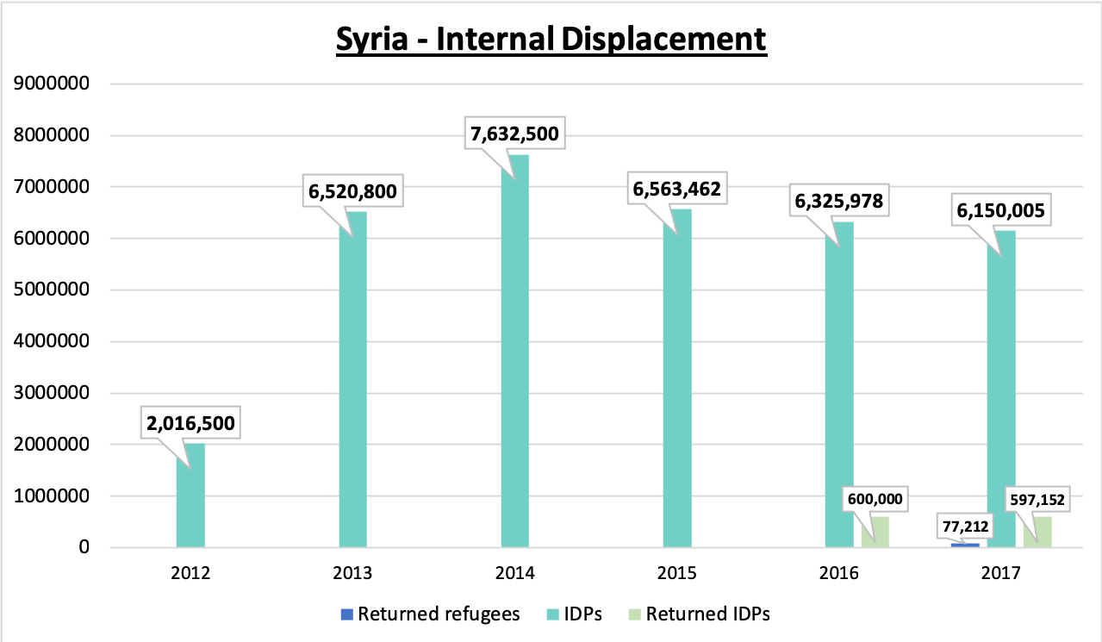
Internal Displacement – Time Series

Slide 6
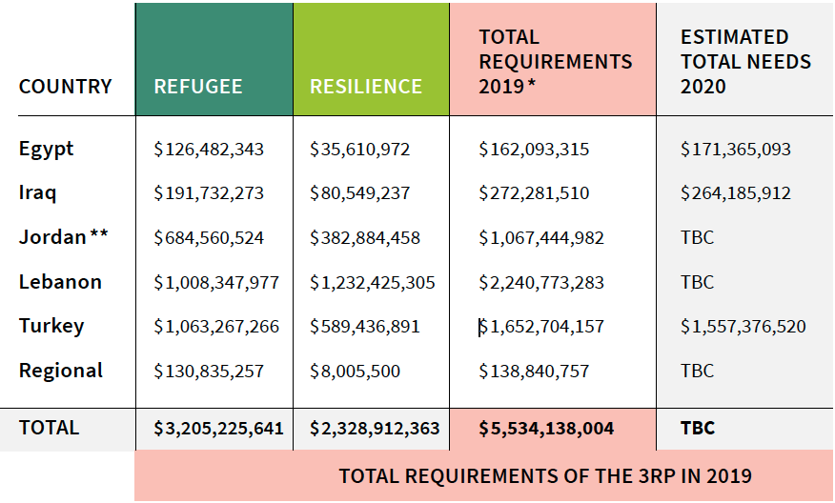
UNHCR – 3RP Funding Requests Remain Unmet
Source: United Nations High Commissioner for Refugees

Slide 7
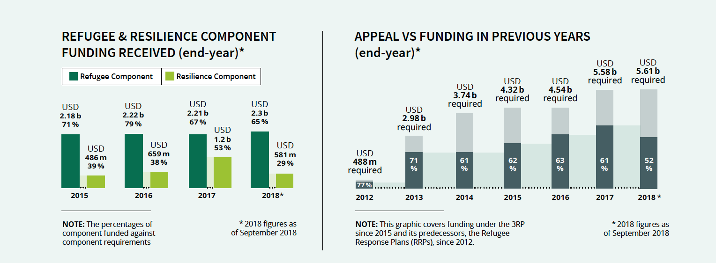
UNHCR – 3RP Funding Requests Remain Unmet
Source: United Nations High Commissioner for Refugees

Slide 8
Refugee Flows and US Humanitarian Relief
Research Question(s):
How does US humanitarian relief compare with Syrian refugee flows to Turkey and internal displacement within Syria?
How does US humanitarian aid change over time?
Is there a positive correlation between refugee population increases/decreases and US foreign aid?

Slide 9
A positive relationship between refugees and aid?
The US: “The United States remains the single-largest global donor of humanitarian assistance to help those affected by the conflict, both inside Syria and in neighboring countries” (ForeignAssistance.gov)
FY2017 requests funding for emergency aid & sustainable response aid to Syria and neighboring countries/host communities
The UNHCR: “Funding received for the resilience component has also increased from US$486 million in 2015 to US$822 million in 2017. This significant increase reflects the needs as well as the commitment of partners and donors to support resilience among refugees, host communities and local and national institutions. However, the resilience component remains critically underfunded in terms of the overall appeal.” (UNHCR 3RP Overview 2019/2020)
Notes:
* Be sure here to include a direct link to how I chose my variables and make a clear connection between my hypothesis and how I’ve operationalized my research draw literal lines between research questions and variables

Slide 10
Changes in refugee population : changes in humanitarian aid
Independent variables: (how do refugee populations change over time?)
Population of Syrian refugees in Turkey
Measurement: number of Syrian individuals (refugees & asylees) in Turkey
Population of internally displaced Syrians
Measurement: number of internally displaced persons within Syria
Dependent variables: (how does humanitarian aid change over time?)
Humanitarian aid going to Turkey
Measurement: total award amount (USD)
Humanitarian aid going to Syria
Measurements: total award amount (USD)

Slide 11
UNHCR Refugee Population Data UNHCR Population Statistics – Time Series
Turkey:
Select fields
Asylum seekers, refugees
Export CSV
Re-save as Excel (data compatibility)
Syria:
Select fields
Internally displaced persons
Export CSV
Re-save as Excel

Slide 12
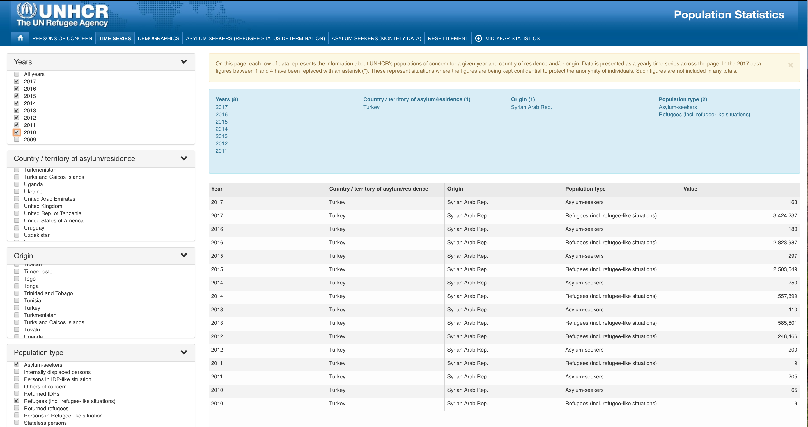

Slide 13
ForeignAssistance.gov
Open data source
Central repository for all organizations who have a role in foreign assistance
Standardized reporting requirements for reporting agencies – standardized data format
Minimum base year 2015
Requested – appropriated – obligated – spent
Full set/partial data
Some reporting agencies unable to fulfill all reporting requirements
Disaggregated data provided for every transaction within an agency

Slide 14
Validation – types of aid
Aid types provided by the US
Aid types requested by the UNHCR
Notes:
Compare the types of aid provided by the US with the types of aid requested by the UNHCR for the Syrian response
Why did I chose this source
Take a subsample comparison of variables
Sub sample comparison of observation
Compare what I observed with some other external observations that look at the same thing (my observations to UN underfunding observations)

Slide 15
Data Management
Notes:
Show how I structure folders

Slide 16
Workflow

Slide 17
Problems and Setbacks
Asking the right questions, leaving some questions unanswered
“…but is that the point of this class?”
Qualitative → Quantitative
The python learning curve
Foreign assistance data quality

Slide 18
The Takeaway
Notes:
Of data managment
- Show a higher level of thinking

Slide 19
Questions?

